Slide 1
: Domain-Specific Accelerator Generator Hardware Perspective
Sihao Liu
PolyArch Research Group
University of California, Los Angeles
Oct 2nd, 2022; MICRO 2022 Tutorial
(2:30 PM – 4:15 PM)

Slide 2
Outline
Micro-architecture Overview (30 min)
Stream Dispatcher
Spatial Memory System & Sync. System
Spatial Compute System
Coffee Break (30 min)
Hand-on: Compose Your Own DSA (30 min)
Architecture Description Graph (ADG)
Using our own DSA by using Domain-specific Language
Hard-on: RTL & FPGA Simulation (15 min)
How to do RTL simulation with customized ISA
Understand the simulation log and FPGA Flow

Slide 3
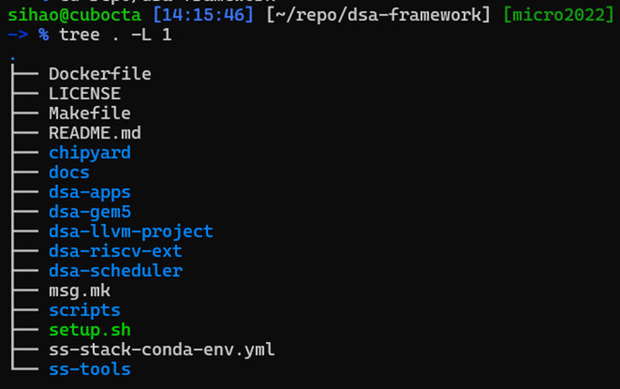
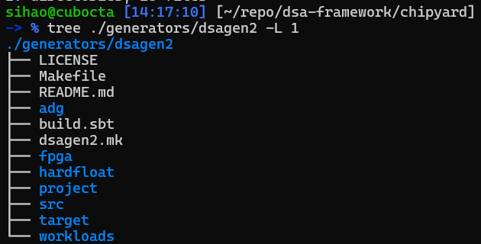
Before we start: Code Structure Overview
ChipYard
SoC integration, RTL sim, FPGA
DSAGEN2
Implementation of DSA , Overlay, Test
Path: dsa-framework/chipyard
Path: dsa-framework/chipyard/generators/dsagen2

Slide 4
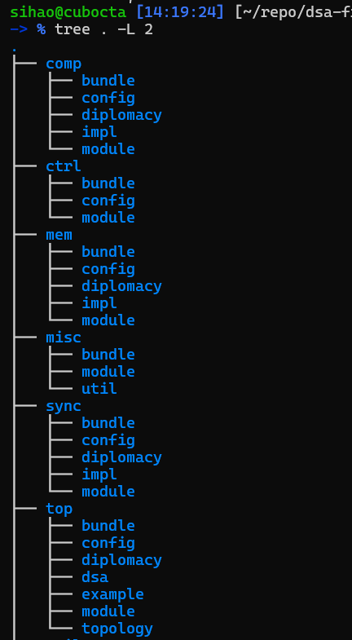
Before we start: DSAGEN Code Structure
Path: dsa-framework/chipyard/
generators/dsagen2
Four major components:
comp: spatial computing system, CGRA
ctrl: stream management
mem: memory system, DMA, Scratchpad, etc.
sync: vector ports, data synchronization
Common structure:
bundle: IO interface definition
config: reconfiguration part, the “Chisel” part
diplomacy: parameter handshake for arbitrary topology
impl: hardware implementation, the “Verilog” part
module: connect “Chisel” and “Verilog” part
Note: The whole project is written in Chisel (Scala)
“Chisel”: flexible, parameterizable part of design
“Verilog”: static, fixed part of design
source code
components

Slide 5
Outline
Micro-architecture Overview (30 min)
Stream Dispatcher
Spatial Memory System & Sync. System
Spatial Compute System
Coffee Break (30 min)
Hand-on: Compose Your Own DSA (30 min)
Architecture Description Graph (ADG)
Using our own DSA by using Domain-specific Language
Hard-on: RTL & FPGA Simulation (15 min)
How to do RTL simulation with customized ISA
Understand the simulation log and FPGA Flow
Notes:
Here is an outline of this section. We first look at the high-level programming interface.

Slide 6
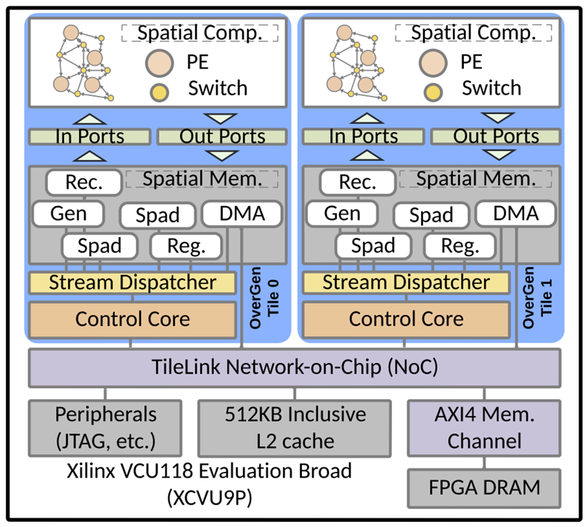
DSAGEN Architecture Overview
Integrate as RoCC accelerator
DCache (HellaCache) for bitstream load
L2 Cache access via NoC
Multi-core support
FPGA proved
Four major subsystem:
Spatial Compute System – CGRA Generator
Spatial Memory System – Memory Gen.
Synchronization System – Vector ports
Control System – Manage Streams

Slide 7
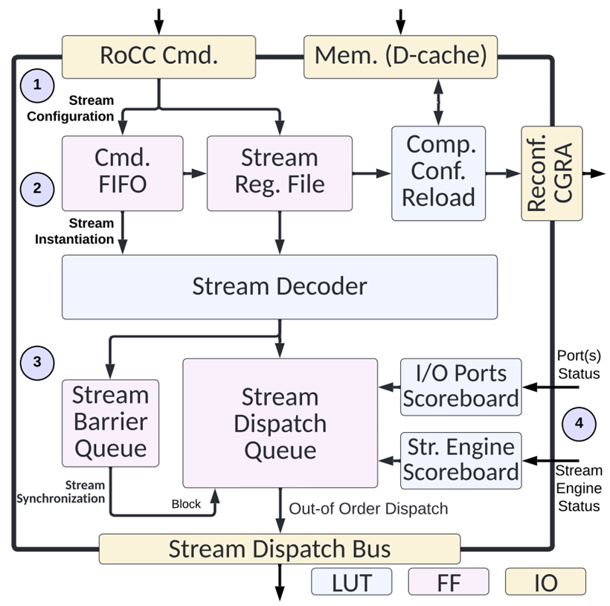
Control System: Stream Dispatcher
Source Code Path
chipyard/generators/dsagen2/src/main/scala/dsagen2/
ctrl/module
RoCC interface entrance
Dcache (HellaCache) for bitstream load
Stream Command Decode
A simple out-of-order issue queue
Support barrier command
Notes:
Need to motivate people
The purpose of stream dispatcher, what does this unit do, stream command coordination
talking about the stream disp function
What id the design requirement
Issue command quickly back to back,
Quickly close timing what is the round-trip time
How does the micro-arch
Another interface for RoCC
Big purpose: get people motivated, show the purple of each component, explain why it is interesting why and why not.
Why RoCC, how does RoCC work; what is the benefit of design like that
What is the unit? What is the design requirement? What is our motivation? What the design is? XYZ?

Slide 8
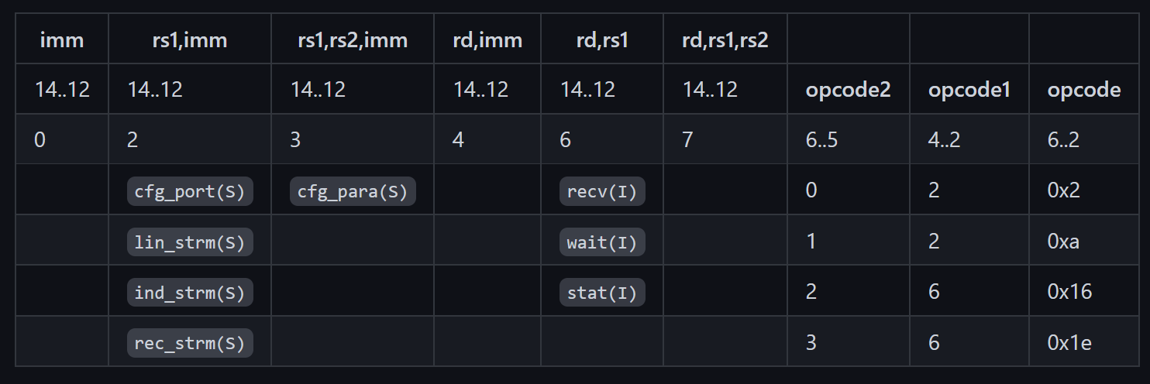
Stream Dispatcher: Why we need it?
A bridge between RISC-V and DSA
Manage the stream pattern parameters
Manage stream dependency & resources
Solve stream conflicts – Out-of-order issue
Config Stream
Control
Stream
Start
Stream

Slide 9
Stream Concurrent Execution Model
Control Core
b[N+1:2N]
for (int j = 0; i < M; ++j)
for (int i = 0; i < N; ++i)
c[j*K+i] += a[j*K+i] * b[j*K+i];
a[N+1:2N]
Concurrent
(Out-of-Order)
c[N+1:2N]
Sequential
Memory
a[0:N]
b[0:N]
c[0:N]
a[N+1:2N]
b[N+1:2N]
c[N+1:2N]
Streams
a[0:N]
b[0:N]
c[0:N]
Input port
×
×
＋
Dataflow
＋
c[N+1:2N]
Output port
c[0:N]
Notes:
Point the problem of execution mode, and introduce the hardware to solve that

Slide 10
Stream Dispatcher: What does it do?
SS-Inst
Stream-Specialized Instruction (SS-Inst) arrived
SS-Inst goes buffered in command FIFO
Each SS-Inst can update up to two parameters in Reg. File
Config to special registers will trigger bitstream reload

Slide 11
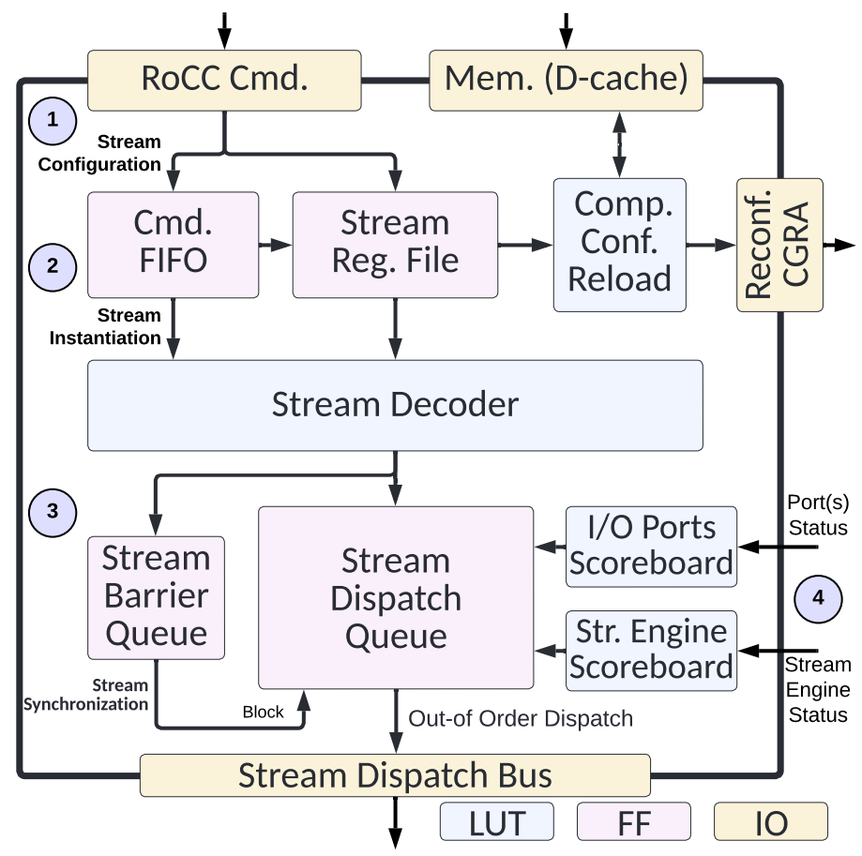
Stream Dispatcher: What does it do?
Stream-Specialized Instruction (SS-Inst) arrived
SS-Inst goes buffered in command FIFO
Each SS-Inst can update up to two parameters in Reg. File
Config to special registers will trigger bitstream reload
SS-Inst can trigger stream instantiation
Parameter values read out from register file
Decode stage forms stream entry with elaborated param.
Elaborated stream entry sent to stream dispatcher queue
SS-Inst
addr, 1d/2d, len, etc.
stream entry

Slide 12
Stream Dispatcher: What does it do?
Stream-Specialized Instruction (SS-Inst) arrived
SS-Inst goes buffered in command FIFO
Each SS-Inst can update up to two parameters in Reg. File
Config to special registers will trigger bitstream reload
SS-Inst can trigger stream instantiation
Parameter values read out from register file
Decode stage forms stream entry with elaborated param.
Elaborated stream entry sent to stream dispatcher queue
Barrier entry can also be formed and put into Queue
Dispatch queue checks idle/busy of scoreboard
If the target stream engines (explained later) busy?
If the target ports busy?
SS-Inst
addr, 1d/2d, len, etc.
Busy/Idle?
barrier
Busy/Idle
?
stream entry

Slide 13
Stream Dispatcher: What does it do?
Stream-Specialized Instruction (SS-Inst) arrived
SS-Inst goes buffered in command FIFO
Each SS-Inst can update up to two parameters in Reg. File
Config to special registers will trigger bitstream reload
SS-Inst can trigger stream instantiation
Parameter values read out from register file
Decode stage forms stream entry with elaborated param.
Elaborated stream entry sent to stream dispatcher queue
Barrier entry can also be formed and put into Queue
Dispatch queue checks idle/busy of scoreboard
If the target stream engines (explained later) busy?
If the target ports busy?
Dispatched to target stream engine
SS-Inst
addr, 1d/2d, len, etc.
Busy/Idle?
barrier
Busy/Idle
?
stream entry

Slide 14
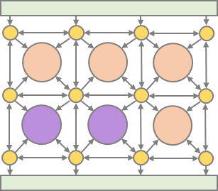
Memory System: Design Requirement? Why?
DRAM (~GB)
Scratchpad
Memory
(~KB)
Recurrence
Bus
Stream
Generation
Scalar (Reg)
Retrieve
DMA
Scratchpad
Memory
Recurrence Engine
Generate Engine
Register Engine
Main Memory
Design requirement
We want to keep hardware simple – A shared-module design methodology
We want it to have high-performance – A fully-pipelined design
We want it to be physical design friendly – Conservative timing, blocked memory
Notes:
Load and Store data
What is the requirement
Multiple stream
Arbitrate stream
Need to be fully pipeline and full saturate the hardware
Critical path and timing issue
Different kinds of memory nodes
Keep the hardware simple, modularity
Share the pipeline
Why we have common data path

Slide 15
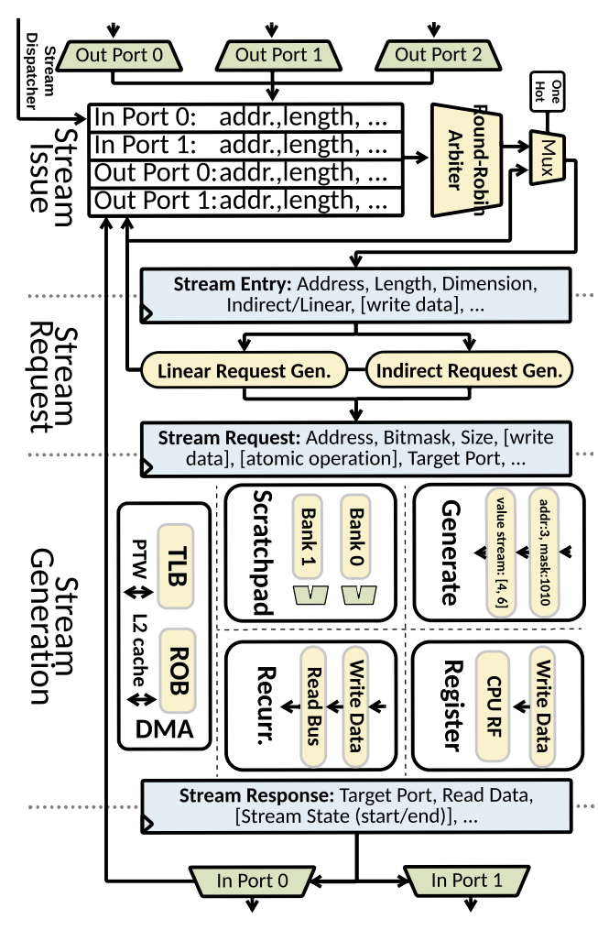
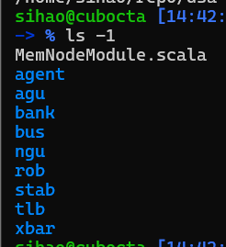
Memory System: Why we need it?
Convert to actual data stream.
Decide which takes resource
Address generation based on
Report stream engine busy/idle to Stream Dispatcher
stream entry
stream entry
Stream
Issue
stream entry
Stream
Request
Source Code Path
$SSchipyard/generators/dsagen2/src/main/scala/dsagen2/
mem/module
Code Organization
agent DMA Only, TileLink Requestor/Receiver
agu Stream Request stage
bank Scratchpad Bank (FPGA BRAM optimized)
bus Broadcast stream response to all In Ports
ngu Generate Engine only, affine sequence
rob DMA Only, re-order memory response
stab Stream Table of Stream Issue stage
tlb DMA Only, address translation
xbar solve Scratchpad Bank conflict
Stream
Generation

Slide 16
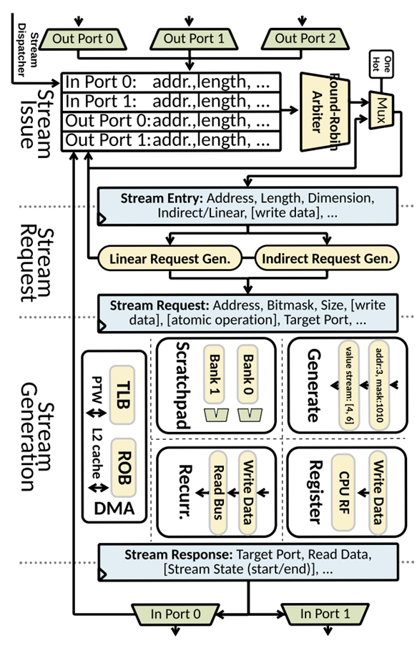
Memory System: What does it do?
read stream 1
Stream Entries are dispatched to Stream Table
Each stream entry relates to a certain port
Read streams and write streams are mixed
Stream
Issue
read stream 2
write stream 1
Stream
Request
Stream
Generation

Slide 17
Memory System: What does it do?
Stream Entries are dispatched to Stream Table
Each stream entry relates to a certain port
Read streams and write streams are mixed
Stream Entries are issued to Stream Request
A simple round-robin style is enough for most case*
Stream
Issue
read stream 1
read stream 2
write stream 1
Stream
Request
Stream
Generation

Slide 18
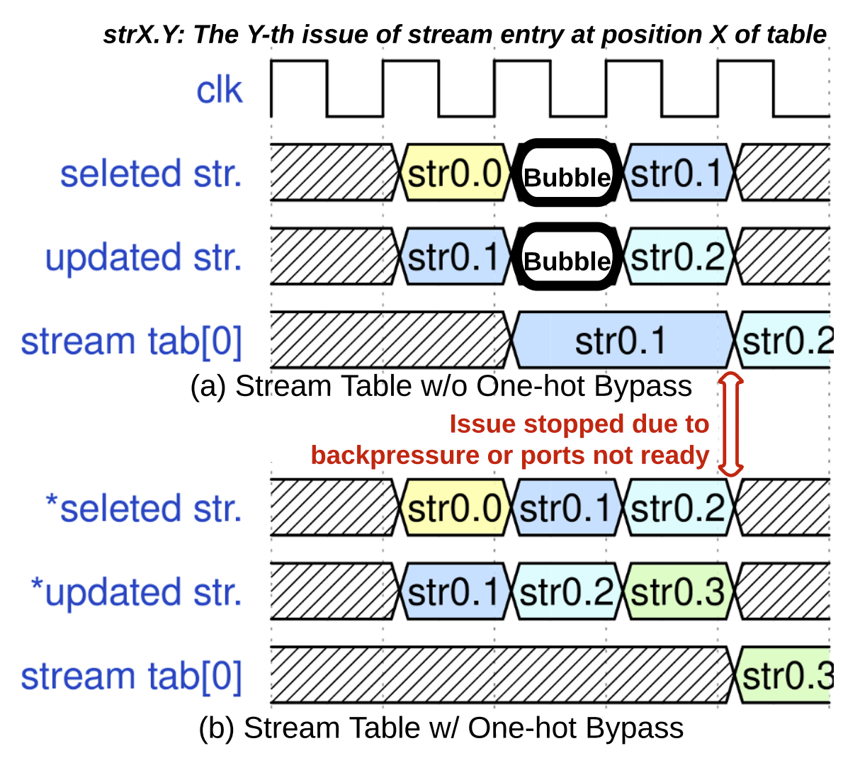
Memory System: What does it do?
Stream Entries are dispatched to Stream Table
Each stream entry relates to a certain port
Read streams and write streams are mixed
Stream Entries are issued to Stream Request
A simple round-robin style is enough for most case*
Optimization can be applied here – One-hot bypass
Stream
Issue
read stream 2
write stream 1
Stream
Request
read stream 1
Stream
Generation

Slide 19
Memory System: What does it do?
Stream Entries are dispatched to Stream Table
Each stream entry relates to a certain port
Read streams and write streams are mixed
Stream Entries are issued to Stream Request
A simple round-robin style is enough*
Optimization can be applied here – One-hot bypass
Elaborated stream entry converted to address and bitmask
Stream
Issue
read stream 2
write stream 1
Stream
Request
read stream 1
addr, bitmask: [00111111]
Stream
Generation

Slide 20
Memory System: What does it do?
Stream Entries are dispatched to Stream Table
Each stream entry relates to a certain port
Read streams and write streams are mixed
Stream Entries are issued to Stream Request
A simple round-robin style is enough*
Optimization can be applied here – One-hot bypass
Elaborated stream entry converted to address and bitmask
Stream Generation uses address and bitmask for memory
Read data from main memory / scratchpad bank / generate ...
Stream
Issue
read stream 2
write stream 1
Stream
Request
read stream 1
addr, bitmask: [00111111]
Stream
Generation
data: [--, BB, XX, YY]

Slide 21
Memory System: What does it do?
Stream Entries are dispatched to Stream Table
Each stream entry relates to a certain port
Read streams and write streams are mixed
Stream Entries are issued to Stream Request
A simple round-robin style is enough*
Optimization can be applied here – One-hot bypass
Elaborated stream entry converted to address and bitmask
Stream Generation uses address and bitmask for memory
Read data from main memory / scratchpad bank / generate ...
Write data to main memory / scratchpad bank / recurrence
Stream
Issue
read stream 2
write stream 1
Stream
Request
read stream 1
addr, bitmask: [00111111]
Stream
Generation
data: [--, BB, XX, YY]

Slide 22
Memory System: What does it do?
Stream Entries are dispatched to Stream Table
Each stream entry relates to a certain port
Read streams and write streams are mixed
Stream Entries are issued to Stream Request
A simple round-robin style is enough*
Optimization can be applied here – One-hot bypass
Elaborated stream entry converted to address and bitmask
Stream Generation uses address and bitmask for memory
Read data from main memory / scratchpad bank / generate /...
Write data to main memory / scratchpad bank / recurrence /...
Stream Response (for read stream only)
Send data (broadcast) to all In Ports
Stream
Issue
read stream 2
write stream 1
Stream
Request
Stream
Generation
read stream 1
addr, bitmask: [00111111]
data: [--, BB, XX, YY]

Slide 23
Vector Ports: What? Why?
Spatial Memory System
A synchronization interface between mem. and comp.
A crossbar (for data alignment) + memory banks (storage)
Main
Memory
Scratch
pad
1
Scratch
pad
2
read stream 1
addr, bitmask: [00111111]
data: [--, BB, XX, YY]
Vector Port
Bank
Bank
Spatial
Compute
System
Notes:
Basic implementation and Stream State and Port Repeat

Slide 24
Vector Ports: What? Why?
Spatial Memory System
A synchronization interface between mem. and comp.
A crossbar (for data alignment) + memory banks (storage)
A small finite state machine
Broadcast (duplicate) stream
Repeat previous stream response
Padding the response to make it multiple of vector length
Main
Memory
Scratch
pad
1
Scratch
pad
2
read stream 1
addr, bitmask: [00111111]
data: [--, BB, XX, YY]
Vector Port
b [...] = a[...] + a [...]
VP
Linear 2D stream:
Bank
Bank
a[...]
[1, 3, 5, 7, 9, 11, 13 ]
[1, 3, 5, 7, 9, 11, 13]
[3, 5, 7, 9, 11, 13, 17]
VP 1
VP 2
[1, 3, 5, 7, 9, 11, 13]
x3
VP
Spatial
Compute
System
[1, 3, 5, 7, 9, 11, 13]
[1, 3, 5, 7, 9]
x2
[1, 3, 5, 7 ]
[9, 11, 13, --]
+
[1, 3, 5, 7, 9]
Vector x 4
[1, 3, 5]
x1
[3, 5, 7, 9]
[11, 13,17, -- ]
Notes:
The to

Slide 25
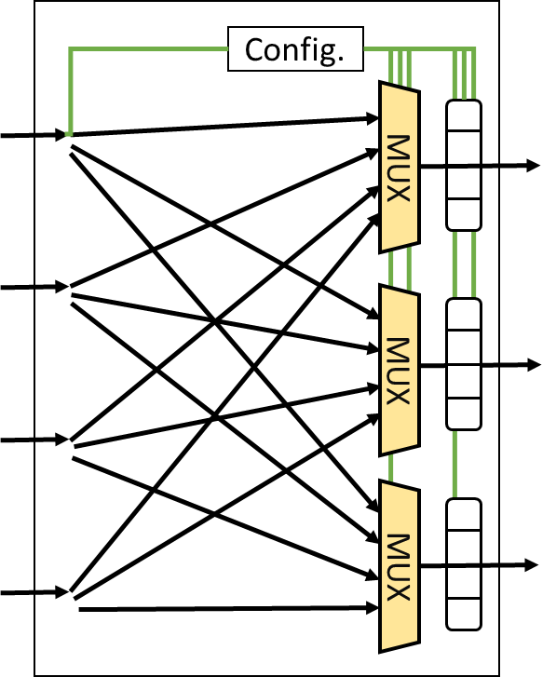
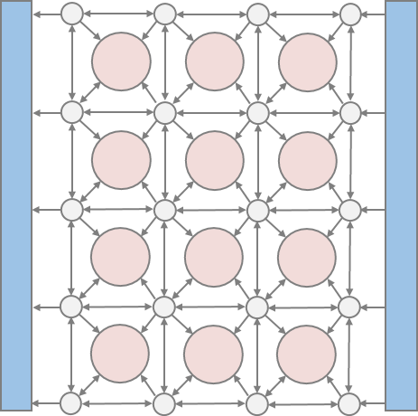
Spatial Computing System – DSA-CGRA-GEN
MUX
MUX
Processing Element (PE)
Switch (SW)
Instruction Buffer
Function
Unit
Register
File
Instruction Scheduler
A 2-input 1-Output Processing Element (PE)
A 4-Input 3-Output Switch
Check our old tutorial for details

Slide 26
Before Coffee Break: Hand-on Exercise
Build a Demo DSA and Compile to RTL Simulation File
Compile to Verilator/VCS Simulation File
$ cd $SS/chipyard
$ make -C sims/verilator CONFIG=DemoDSARocketConfig

Slide 27
Before Coffee Break: Hand-on Exercise
Build a 7x5 Mesh CGRA and Compile to RTL Simulation File
Compile to Verilator Simulation File
$ cd $SS/chipyard
$ make -C sims/verilator CONFIG=MeshDSARocketConfig

Slide 28
Coffee Break (3:00 ~ 3:30pm)
Notes:
Thing:
Nowhere in the ports, core port serialization. Stream is design to be concurrent and the only place it is serialized is stream to the same port
Hard to understand the stream dispatcher, need a slide to include the stream concurrent execution model

Slide 29
Outline
Micro-architecture Overview (30 min)
Stream Dispatcher
Spatial Memory System & Sync. System
Spatial Compute System
Coffee Break (30 min)
Hand-on: Compose Your Own DSA (30 min)
Architecture Description Graph (ADG)
Using our own DSA by using Domain-specific Language
Hard-on: RTL & FPGA Simulation (15 min)
How to do RTL simulation with customized ISA
Understand the simulation log and FPGA Flow
Notes:
Here is an outline of this section. We first look at the high-level programming interface.

Slide 30
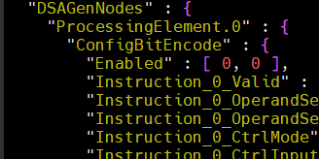
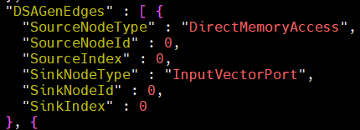
Architecture Description Graph (ADG)
Two ways to describe Domain-specific Accelerator (DSA)
A machine-friendly format (JSON) that records parameters + topology of DSA
A human-understandable format (Scala) that used for manual design
A JSON-list for DSA Nodes: Param.
A JSON-list for DSA Edges: Topology
Example Path
$SS/chipyard/generators/dsagen2/adg/Mesh2x2-Simple64-I2O2.json
Notes:
two representation of the ADG,
Scala and JSON and brief

Slide 31
Compute System: An CGRA Generator
val vport_i1 = createIVP(new FullIVPConfig)
val vport_i2 = createIVP(new FullIVPConfig)
val vport_o1 = createOVP(new FullOVPConfig)
val vport_o2 = createOVP(new FullOVPConfig)
vport_i1
vport_i2
sw1
sw2
val sw1 = createCompNode(new DefaultSWConfig)
val sw2 = createCompNode(new DefaultSWConfig)
val sw3 = createCompNode(new DefaultSWConfig)
val sw4 = createCompNode(new DefaultSWConfig)
pe
sw3
sw4
vport_o1
vport_o2
val pe = createCompNode(new PE_Simple_Config)

Slide 32
A Scala Embedded DSL – Build A Simple CGRA
// define connection vport_i1 --> sw1; vport_i1 --> sw2 vport_i2 --> sw1; vport_i2 --> sw2
sw3 --> vport_o1; sw3 --> vport_o2 sw4 --> vport_o1; sw4 --> vport_o2
sw1 <-> sw2 sw1 <-> sw3 sw2 <-> sw4 sw3 <-> sw4
sw1 --> pe sw2 --> pe sw3 --> pe sw4 <-> pe
vport_i1
vport_i2
sw1
sw2
pe
sw3
sw4
vport_o1
vport_o2

Slide 33
A Scala Embedded DSL – Adding Memory System
// adding memory val dma0 = createMemNode(new DefaultDMAConfig)
// connecting memory to VPs
dma0 --> vport_i1
dma0 --> vport_i2
vport_o1 --> dma0
vport_o2 --> dma0
// Finalized stage
autoConfigure()
tlNode := getMemAggTLNode
override val nPTWPorts: Int = numDMA
vport_i1
vport_i2
sw1
sw2
DMA
pe
sw3
sw4
vport_o1
vport_o2

Slide 34
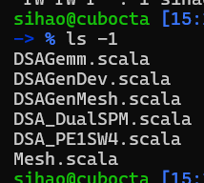
A Scala Embedded DSL – Build A Simple CGRA
Example Path
$SS/chipyard/generators/dsagen2/
src/main/scala/dsagen2/top/example
vport_i1
vport_i2
sw1
sw2
DMA
pe
sw3
sw4
vport_o1
vport_o2
Notes:
path to the example files

Slide 35
Hand-on Exercise (30 min)
Build a Demo DSA and Compile to RTL Simulation File
Compile to Verilator/VCS Simulation File
$ cd $SS/chipyard
$ make -C sims/verilator CONFIG=DemoDSARocketConfig

Slide 36
Hand-on Exercise (30 min)
Build a 7x5 Mesh CGRA and Compile to RTL Simulation File
Compile to Verilator Simulation File
$ cd $SS/chipyard
$ make -C sims/verilator CONFIG=MeshDSARocketConfig

Slide 37
Outline
Micro-architecture Overview (30 min)
Stream Dispatcher
Spatial Memory System & Sync. System
Spatial Compute System
Coffee Break (30 min)
Hand-on: Compose Your Own DSA (30 min)
Architecture Description Graph (ADG)
Using our own DSA by using Domain-specific Language
Hard-on: RTL & FPGA Simulation (15 min)
How to do RTL simulation with customized ISA
Understand the simulation log and FPGA Flow
Notes:
Here is an outline of this section. We first look at the high-level programming interface.

Slide 38
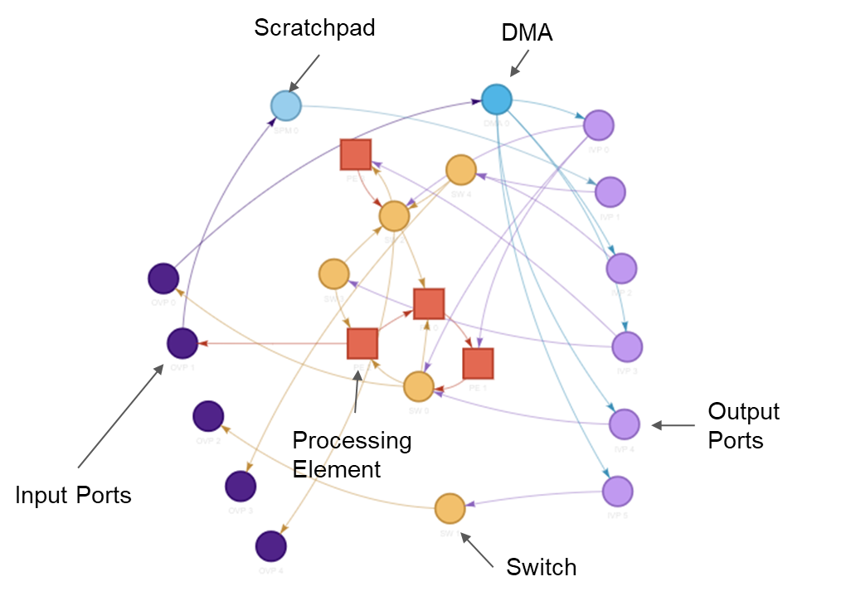
Unit Test DSAGEN generated accelerator
Compile all test binaries
$ cd $SS/chipyard/generators/dsagen2
$ make ADG=<The ADG we just built.json> compile-microbench
$ cd adg
$ python3 $SS/scripts/sched_visualization.py Mesh7x5-Full64-Full7I5O.json
Run all unit tests
$ cd $SS/chipyard
$ make -C sims/verilator CONFIG=MeshDSARocketConfig ss-run

Slide 39
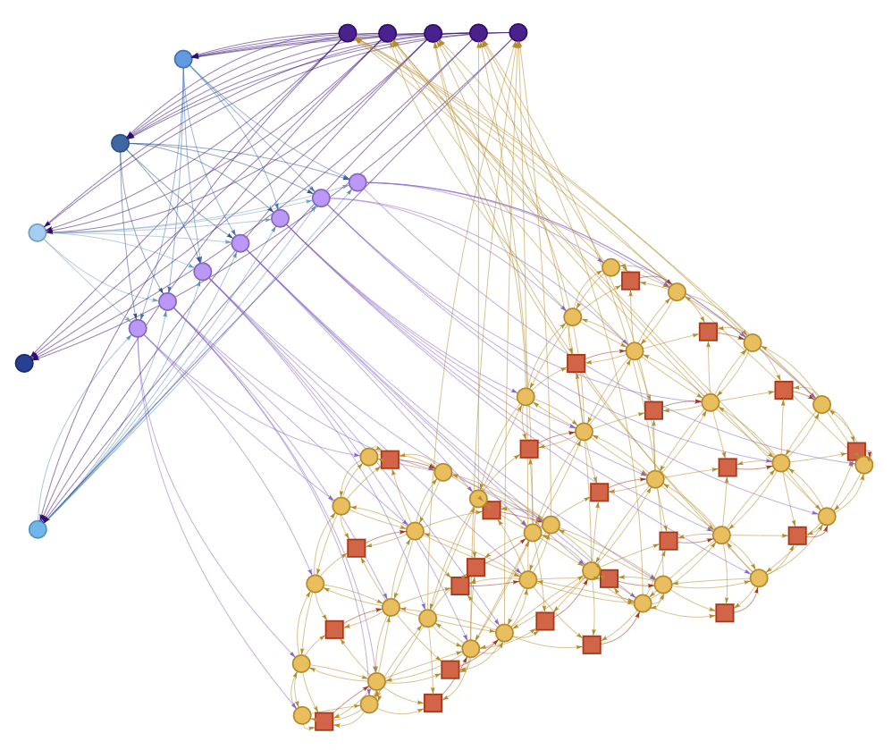
Unit Test DSAGEN generated accelerator
Scratchpad
DMA
Output Ports
CGRA
Input Ports
Compile all test binaries
$ cd $SS/chipyard/generators/dsagen2
$ make ADG=<The ADG we just built.json> compile-microbench
$ cd adg
$ python3 $SS/scripts/sched_visualization.py Mesh7x5-Full64-Full7I5O.json
Run all unit tests
$ cd $SS/chipyard
$ make -C sims/verilator CONFIG=MeshDSARocketConfig ss-run

Slide 40
RTL Simulation for real workloads
Simulate with RISC-V binaries (mv, crs) from previous session
$ make -C sims/verilator CONFIG=MeshDSARocketConfig BINARY=$SS/dsa-apps/demo/ss-mv.riscv run-binary-fast
$ make -C sims/verilator CONFIG=MeshDSARocketConfig BINARY=$SS/dsa-apps/demo/ss-crs.riscv run-binary-fast

Slide 41
Understand Simulation Log
> chipyard/sims/[vcs/verilator]/output/ MeshDSARocketConfig /*.log
Accelerator part finished
Computation is correct
csv, [CPU #cycle], [1st DSA #cycle], [2nd DSA #cycle]

Slide 42
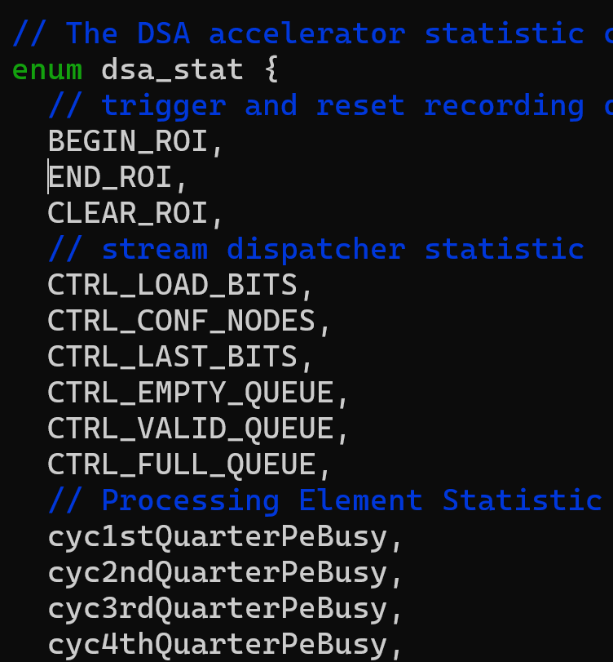
Understand Simulation Log
> chipyard/sims/[vcs/verilator]/output/ MeshDSARocketConfig /*.log
A #cycle breakdown
# configuration cycle
# idle cycle
# busy cycle
...
Full statistic header
dsa-apps/compiled/Common/timing.h
Turn on debug mode
`export DEBUG=1`

Slide 43
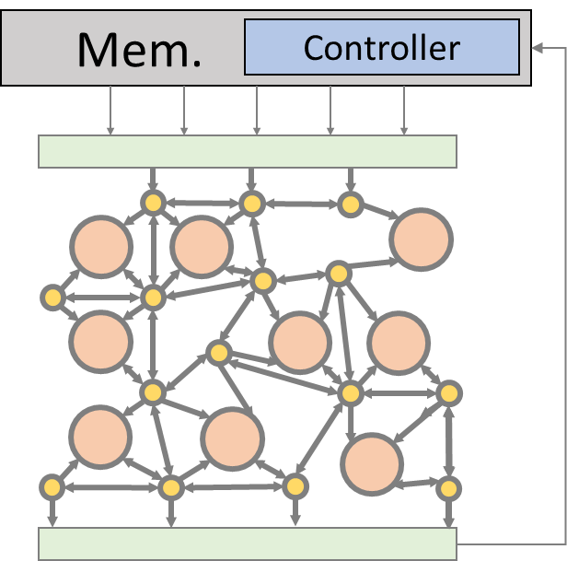
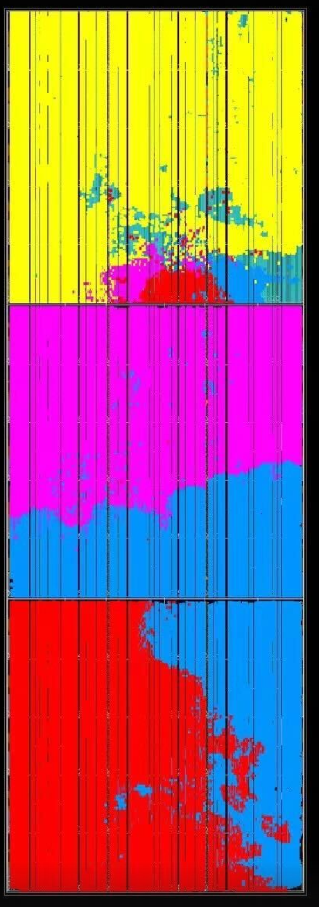
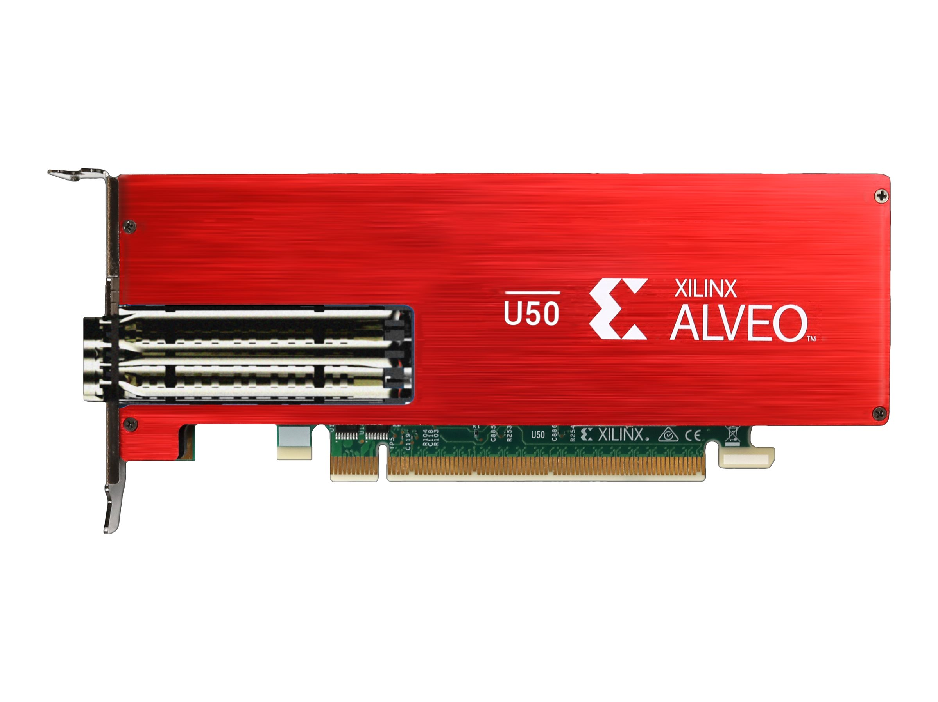
FPGA Overlay Overview
C/C++
Kernels
(pragmas)
LLVM +
Dataflow Compiler
SoC Integration by ChipYard
Compiled
RISCV+Accel
Binaries
Compile
DRAM
Peripherals
LLC
Network-on-Chip
Design-space
Exploration
Runs on
RISCV CPU
RISCV CPU
RISCV CPU
Memory
Acce.
Acce.
Ctrl.
a[0:n]
b[0:n
Physical Design
RTL Generation
＋
＋
＋
Chisel-based
Hardware Generator
＋
Rec Bus
Arch. Desc. Graph
(ADG)
4-Core FPGA Overlay@ 92.7MHz
c[0:n]
FPGA
Notes:
If i want to target FPGA, what should we do

Slide 44
FPGA Overlay Limitation
This is NOT magic! mostly engineering effort.
Heavily depends on FPGA IP generator!
Integration is mostly done by ChipYard
Need to generate Vivado FPGA IP
FPGA Overlay is done by Chisel BlackBox Wrapper

Slide 45
Hand-on: FPGA Flow Command
Compile FPGA bitstream
$ cd $SS/chipyard/fpga
$ make CONFIG=MeshDSARocketVCU118Config100MHz SUB_PROJECT=vcu118 bitstream
FPGA Bring-up Flow
// Where to fine the FPGA Bitstream
$ cd $SS/chipyard/fpga/generated-src/<Your CONFIG>/obj/VCU118FPGATestHarness.bit

